Slide 1
Reptile and Amphibian Study Merit Badge
Troop 344/9344
Pemberville, OH

Slide 2
Requirements
Describe the identifying characteristics of six species of reptiles and four species of amphibians found in the United States. For any four of these, make sketches from your own observations or take photographs. Show markings, color patterns, or other characteristics that are important in the identification of each of the four species. Discuss the habits and habitats of all 10 species.
Discuss with your merit badge counselor the approximate number of species and general geographic distribution of reptiles and amphibians in the United States. Prepare a list of the most common species found in your local area or state.
Describe the main differences between
Amphibians and reptiles
Alligators and crocodiles
Toads and frogs
Salamanders and lizards
Snakes and lizards

Slide 3
Requirements
Explain how reptiles and amphibians are an important component of the natural environment. List four species that are officially protected by the federal government or by the state you live in, and tell why each is protected. List three species of reptiles and three species of amphibians found in your local area that are not protected. Discuss the food habits of all 10 species.
Describe how reptiles and amphibians reproduce.
From observation, describe how snakes move forward. Describe the functions of the muscles, ribs, and belly plates.
Describe in detail six venomous snakes and the one venomous lizard found in the United States. Describe their habits and geographic range. Tell what you should do in case of a bite by a venomous species.

Slide 4
Requirements
Do ONE of the following:
Maintain one or more reptiles or amphibians for at least a month. Record food accepted, eating methods, changes in coloration, shedding of skins, and general habits; or keep the eggs of a reptile from the time of laying until hatching; or keep the eggs of an amphibian from the time of laying until their transformation into tadpoles (frogs) or larvae (salamanders). Whichever you chose, keep records of and report to your counselor how you cared for your animal/eggs/larvae to include lighting, habitat, temperature and humidity maintenance, and any veterinary care requirements.

Slide 5
Requirements
Do ONE of the following:
Choose a reptile or amphibian that you can observe at a local zoo, aquarium, nature center, or other such exhibit (such as your classroom or school). Study the specimen weekly for a period of three months. At each visit, sketch the specimen in its captive habitat and note any changes in its coloration, shedding of skins, and general habits and behavior. Discuss with your counselor how the animal you observed was cared for to include its housing and habitat, how the lighting, temperature, and humidity were maintained, and any veterinary care requirements. Find out, either from information you locate on your own or by talking to the caretaker, what this species eats and what are its native habitat and home range, preferred climate, average life expectancy, and natural predators. Also identify any human caused threats to its population and any laws that protect the species and its habitat. After the observation period, share what you have learned with your counselor.

Slide 6
Requirements
Do TWO of the following:
Identify at night three kinds of toads or frogs by their voices. Imitate the song of each for your counselor. Stalk each with a flashlight and discover how each sings and from where.
Identify by sight eight species of reptiles or amphibians.
Using visual aids, give a brief talk to a small group on three different reptiles and amphibians.
Tell five superstitions or false beliefs about reptiles and amphibians and give a correct explanation for each. Give seven examples of unusual behavior or other true facts about reptiles and amphibians.

Slide 7
Requirement 1
Describe the identifying characteristics of six species of reptiles and four species of amphibians found in the United States. For any four of these, make sketches from your own observations or take photographs. Show markings, color patterns, or other characteristics that are important in the identification of each of the four species. Discuss the habits and habitats of all 10 species.

Slide 8
Reptiles and Amphibians
Click on the following links for information on Reptiles and Amphibians
Reptiles of the United States
Amphibians of the United States
Reptiles of Ohio
Amphibians of Ohio

Slide 9
Requirement 2
Discuss with your merit badge counselor the approximate number of species and general geographic distribution of reptiles and amphibians in the United States. Prepare a list of the most common species found in your local area or state.

Slide 11
Distribution of Reptiles and Amphibians
More kinds of amphibians, and many more kinds of reptiles, live in the southern part of the United States than in the northern part.
The body temperatures of nearly all amphibians and reptiles are primarily determined by external sources of heat such as the sun, water, or ground.
This limits their distribution and activity time, but allows them to live on about one-tenth of the energy that similar-sized mammals and birds require.
Reptiles and amphibians control their body temperatures by moving to cooler or warmer areas as necessary.

Slide 12
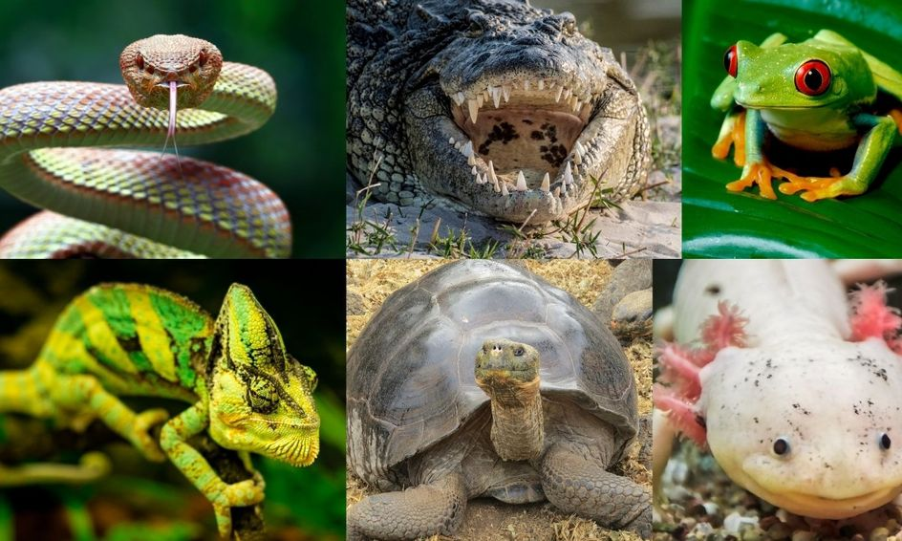
Requirement 3
Describe the main differences between
Amphibians and reptiles
Alligators and crocodiles
Toads and frogs
Salamanders and lizards
Snakes and lizards

Slide 13
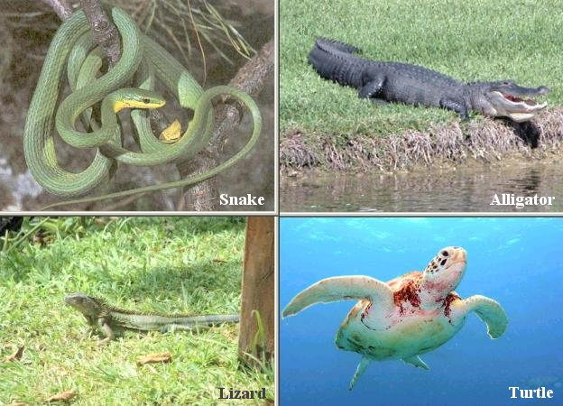
Characteristics of Reptiles
Reptiles include turtles, lizards, snakes, alligators, and crocodiles.
Reptiles are vertebrates. They have backbones.
Their bodies are completely covered with scales.
They are ectothermic animals, which rely on heat to be provided by the environment, as they produce little of their own.
Reptiles produce shelled eggs or bear live young.
All species fertilize eggs internally.
All species of reptiles have at least one lung.

Slide 14
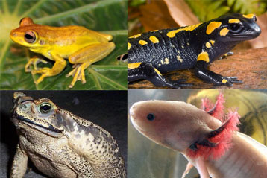
Characteristics of Amphibians
Amphibians include salamanders, frogs, and toads.
Amphibians are vertebrates.
Unlike reptiles, they have moist, glandular skin instead of scales and, except for a few species in which the toes have hardened tips, none have claws.
Amphibians breath through their skin, as well as their lungs in some cases.
Amphibians are cold-blooded.
Many species of amphibians vocalize, i.e. chorus frog.
Most species fertilize eggs externally, some internally.
Most amphibians pass through a larval stage (called tadpoles in frogs and larvae in salamanders), usually in the water, before changing into the adult form.

Slide 15
Alligators and Crocodiles

Slide 16
Alligators and Crocodiles
The easiest way to distinguish between the American alligator and the American crocodile is to look at the head.
The alligator has a broadly rounded snout, whereas the crocodile’s head is almost pointed.
American alligators live primarily in freshwater, while American crocodiles prefer saltwater coastal areas.
Adult alligators are almost black, while American crocodiles are more of an olive brown color.
The fourth tooth on each side of the American crocodile’s lower jaw is quite large and in big specimens fits into a groove on the outside of the upper jaw.

Slide 18
Toads and Frogs
Frogs, in general, have smooth, moist skins and lack the conspicuous bumpy warts and relatively dry skins characteristic of toads.
Some frogs, such as the bullfrog and leopard frog, have webbing between the toes of their hind feet that aids in swimming.
Toads have short hind legs, and when they move they hop.
Frogs have long hind legs and leap.
Toads are much easier to catch than frogs, so toads have another way of avoiding enemies.
Their warts secrete a fluid that is distasteful or even poisonous to many small animals.

Slide 19
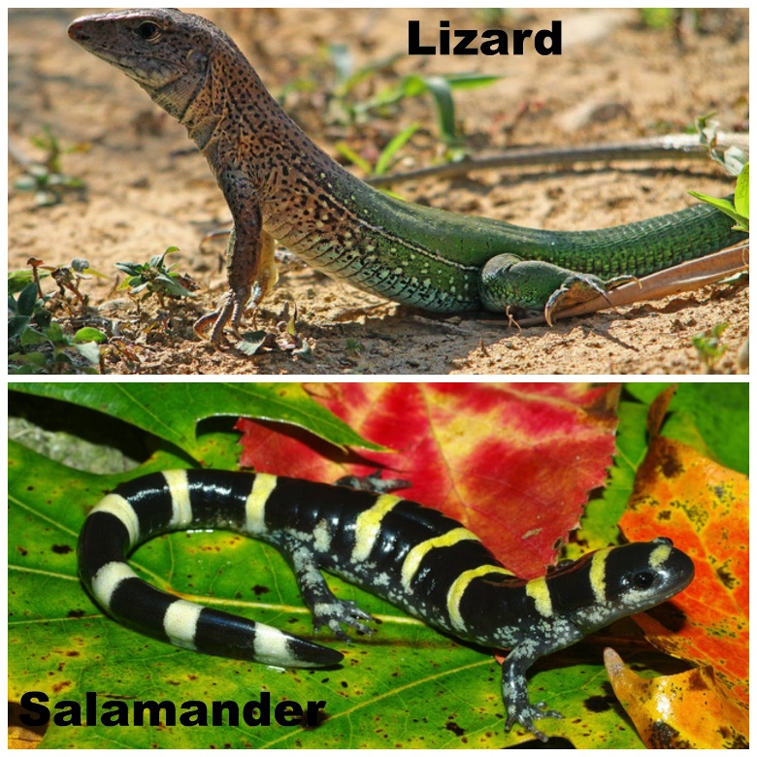
Salamanders and Lizards
Lizards and salamanders are easy to tell apart.
Lizards (reptiles) are covered with scales, their toes have claws, their skins are dry, and they are more likely to be found in the sun.
Salamanders (amphibians) have smooth, moist skins, their toes are clawless, and they avoid exposure to the sun.

Slide 20
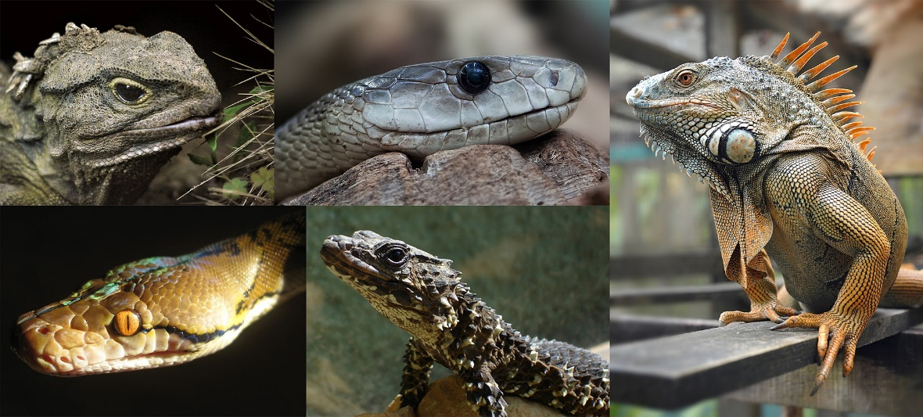

Slide 21
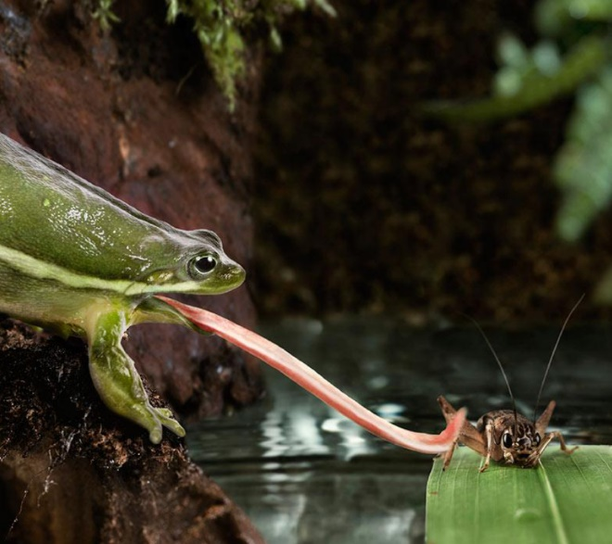
Requirement 4
Explain how reptiles and amphibians are an important component of the natural environment. List four species that are officially protected by the federal government or by the state you live in, and tell why each is protected. List three species of reptiles and three species of amphibians found in your local area that are not protected. Discuss the food habits of all 10 species.

Slide 22
Importance of Reptiles and Amphibians
Reptiles and amphibians play vital roles as predators, prey, and as part of the fundamental framework of nature.
Most lizards, frogs, toads, and salamanders eat insects, helping to control grasshoppers, crickets, ants, beetles, and other insects that can become pests when overly abundant.
Snakes that prey on rats and mice help control rodent outbreaks.
Water snakes and cottonmouths eat dead and diseased fishes that might otherwise infect healthy aquatic animals.

Slide 23
Endangered Reptiles and Amphibians
Click on the following link for the U. S. Fish and Wildlife Endangered Species List.

Slide 24
Reptiles and Amphibians of Ohio
Download the following Field Guides:
Amphibians of Ohio Field Guide
Reptiles of Ohio Field Guide

Slide 25
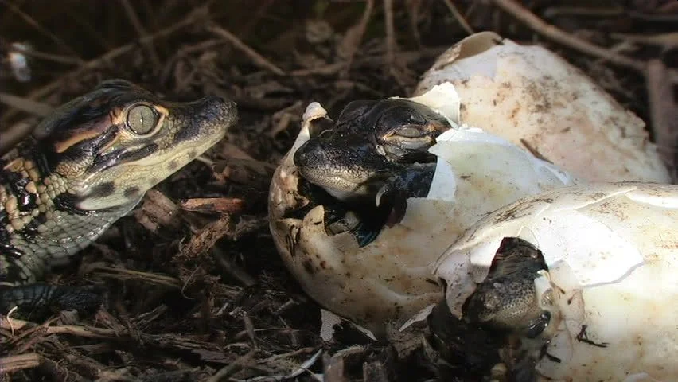
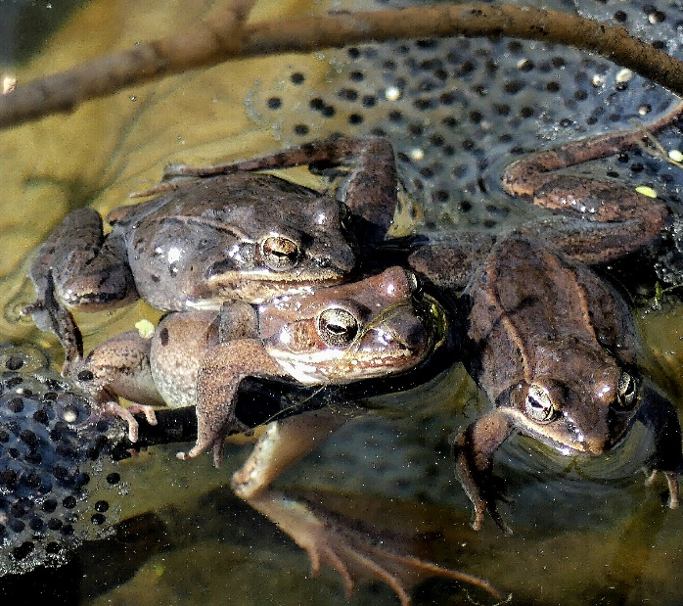
Requirement 5
Describe how reptiles and amphibians reproduce.

Slide 26
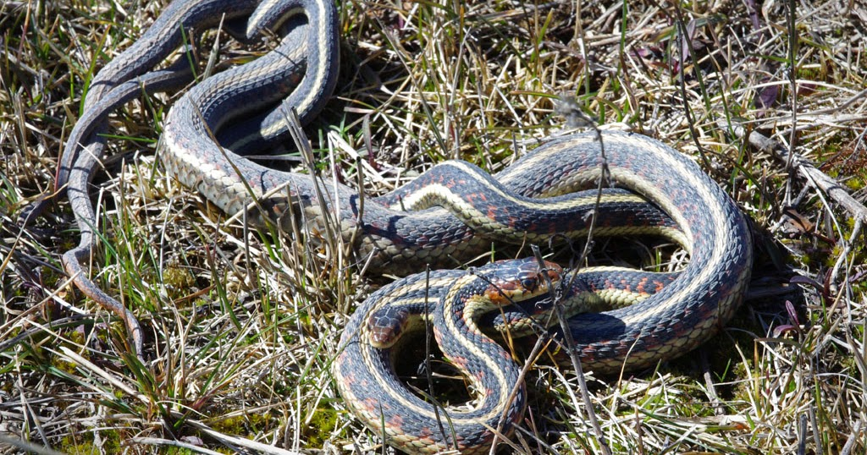
Reptile Reproduction
Fertilization is internal among reptiles.
The mating process is similar to that of mammals.
In general, copulation among snakes and other reptiles takes place a considerable time before the eggs are actually laid.
Mating in most parts of the continental United States usually takes place in spring but also has been recorded at other seasons, notably in autumn.

Slide 27
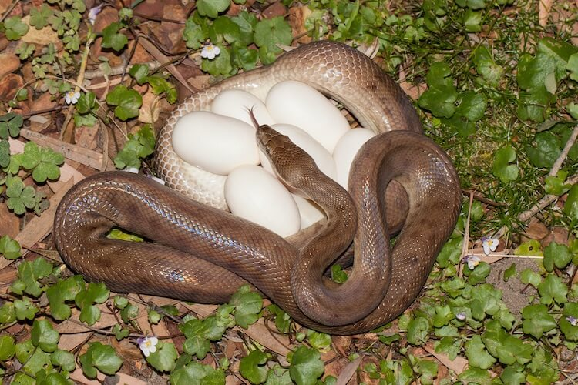
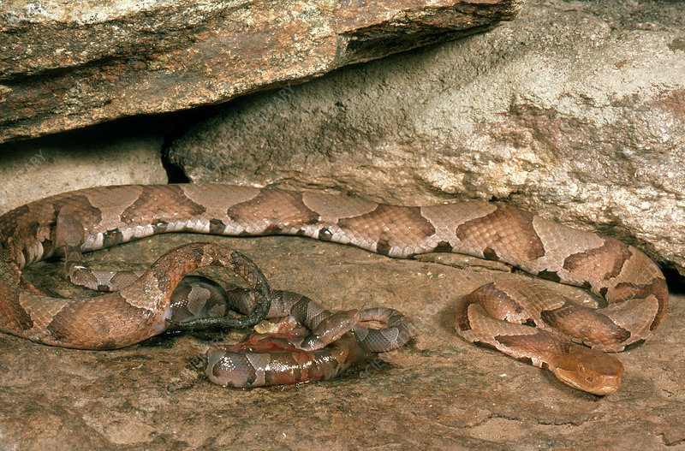
Reptile Reproduction: Snakes
Roughly half of North American snake species lay eggs, which they deposit in places where they are completely out of sight.
Usually the mother snake abandons her eggs soon after laying them, although pythons and some cobras in the tropics remain with their eggs.
Examples of native snakes that lay eggs are the racers, rat, milk, king, and coral snakes.
The other half of North American snake species retain the eggs within the mother’s body until development is complete and the young are born alive.
The young are covered by a thin membrane that they break through shortly after leaving the mother’s body.
Snakes with this type of reproduction include the garter, water, and brown snakes; rattlesnakes; copperheads; and cottonmouths.

Slide 28
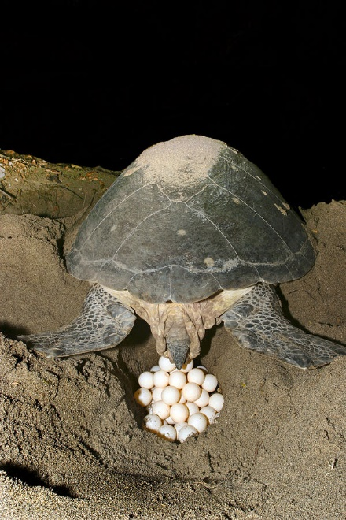
Reptile Reproduction: Turtles
All turtle eggs are laid and hatched on land.
Even the great sea turtles go ashore to lay their eggs, finding a suitable spot, often in slightly moist sandy or loamy soil, and excavating a cavity with the hind legs.
When the eggs are laid, the female turtle scoops and packs the sand or soil back into the hole. She may crawl back and forth, dragging her shell, to conceal the nest.
Weeks or months later, depending on the species and the weather conditions, the eggs hatch.
Most freshwater and land turtles lay eggs in late spring and early summer.
Hatching for most turtles takes place by early fall, but hatchlings of many species do not leave the nest at that time. They remain in the protected cavity through autumn and winter and emerge the next spring.
Hatchlings of aquatic species move toward the nearest water; hatchling land turtles seek the nearest moist cover.

Slide 29
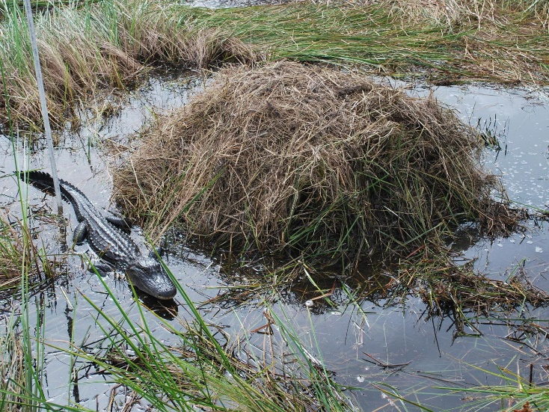
Reptile Reproduction: Alligators/Crocodiles
Alligators build nest mounds of vegetation debris—measuring 4 to 7 feet in diameter and 2 to 3 feet in height—near the water.
The mother alligator lays her eggs in the mound, where heat from the decomposing vegetation helps incubate the eggs.
The mother may remain nearby to guard them and also to uncover them when hatching time arrives.
Crocodiles have similar nesting patterns, although some deposit their eggs in the sand like turtles.

Slide 30
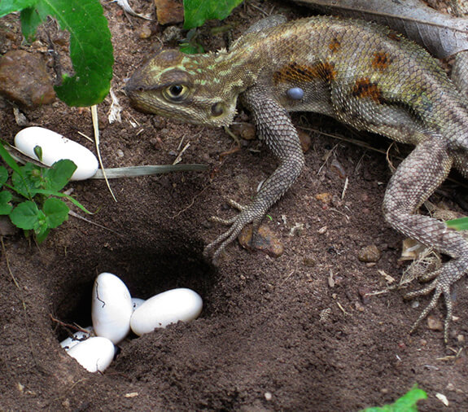
Reptile Reproduction: Lizards
Most North American lizards lay eggs in hidden, slightly moist places.
A few kinds, such as some of the horned lizards and alligator lizards of the western United States, bear living young in the same way many snakes do.
Many species of lizards guard their eggs.
Some assist in incubation by basking in the sun and then returning to their nests where some of the heat they have absorbed is transferred to the developing embryos.

Slide 31
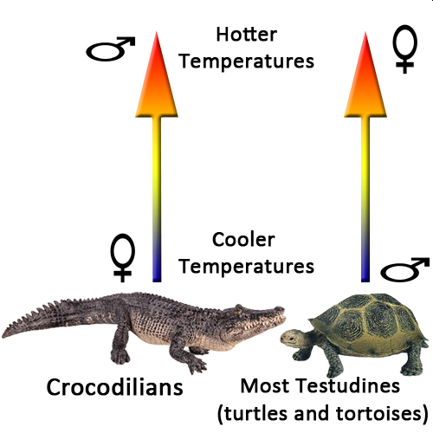
Reptile Reproduction
In many reptiles, including all crocodiles and alligators, most turtles, and some lizards, the gender of the offspring is determined by egg incubation temperature rather than genetics.
In crocodiles, warmer incubation temperatures produce males and cooler temperatures produce females.
In turtles this tends to be just the opposite.
Studies of some lizards, such as leopard geckos, have shown temperature determined gender as well.

Slide 32
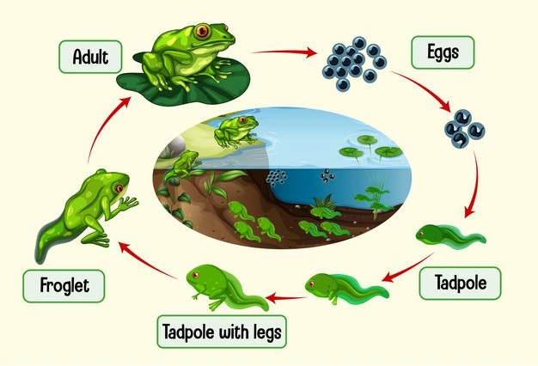
Amphibian Reproduction: Frogs and Toads
Most species of amphibians spend time on land as adults but lay their eggs in water.
At mating time for frogs and toads, the male grasps the female from behind, placing his arms around her waist or under her armpits in a position called amplexus.
As she lays her eggs he releases sperm, some of which enter the eggs. Fertilization is thus external, as it is among most species of fish.
The eggs develop rapidly unless the water is very cold.
Tadpoles hatch from the eggs, and after a growing period ranging from a few weeks to two years, depending on the species, the tadpoles develop legs and lungs and become froglets or toadlets.

Slide 33
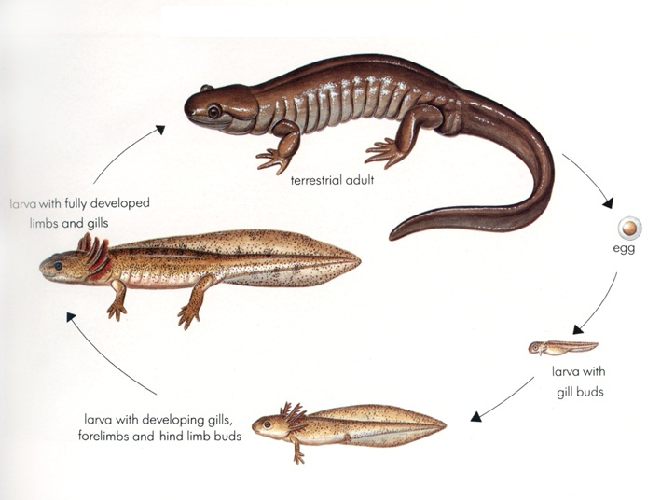
Amphibian Reproduction: Salamanders
During spring or winter rains, male and female salamanders go to shallow wetland ponds to mate.
Once hatched from the eggs, the fishlike salamander larvae have external gills and live in the water for varying lengths of time, depending on the species and local weather conditions, before they transform into adults.
Some types of woodland salamanders lay their eggs in moist underground cavities or under rocks or logs, and development takes place entirely in the egg.
The large (more than 3 feet long) aquatic salamanders of the Southeast, known as sirens, lay their eggs in the water where they live.

Slide 34
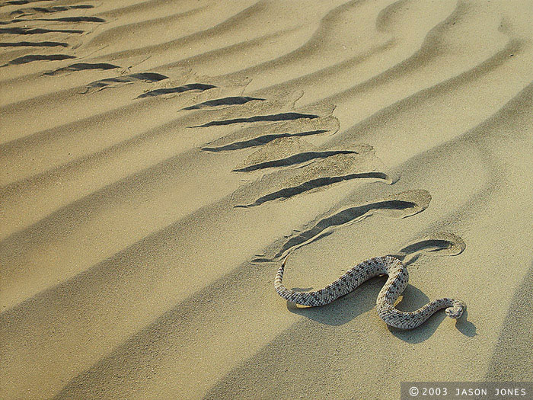
Requirement 6
From observation, describe how snakes move forward. Describe the functions of the muscles, ribs, and belly plates.

Slide 35
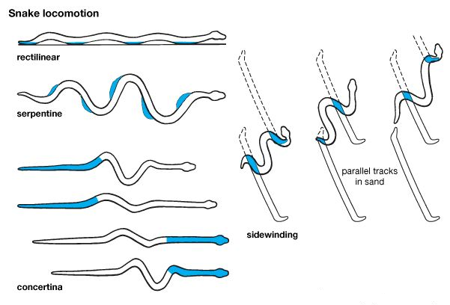
Snake Locomotion
Serpents are very flexible, with a pair of movable ribs for each of the large ventral scales, or plates, on the abdomen.
A system of muscles connects these ribs to the outer edges of the ventral scales.
As the snake flexes these muscles, the free, outer edge of the scales will catch on any small projection or surface irregularity, giving the snake locomotion.
Using this method of crawling, many kinds of snakes can move in a straight line.
Few of them do, though, as they usually take advantage of the terrain and use various projections as pivots against which they can push as they move forward.
With this method, the body moves in S-curves as it follows the head.

Slide 36
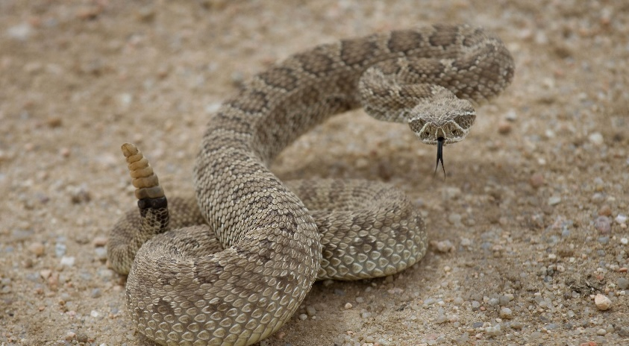
Requirement 7
Describe in detail six venomous snakes and the one venomous lizard found in the United States. Describe their habits and geographic range. Tell what you should do in case of a bite by a venomous species.

Slide 37
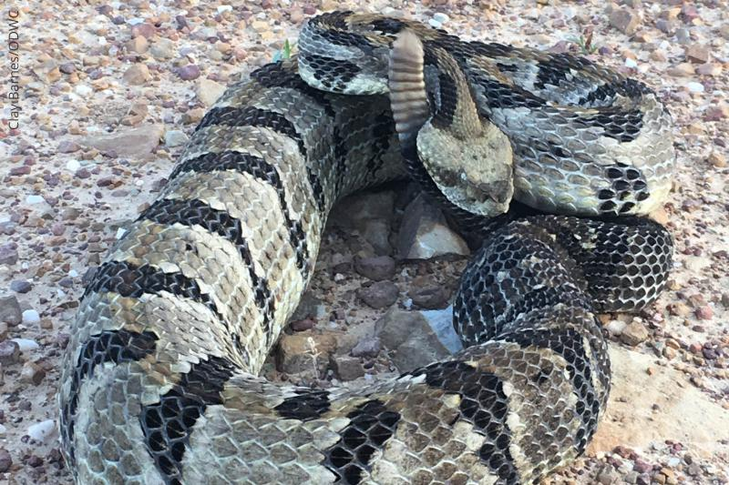
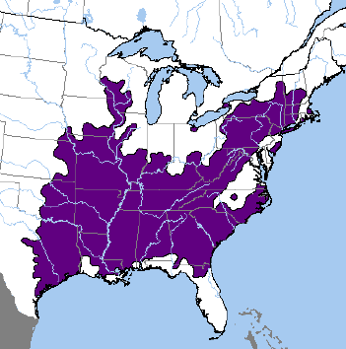
Timber Rattlesnake
Characteristics: Timber rattlesnakes have a broad, triangular head and are the third largest venomous snake in the U.S. Adult timber rattlesnakes reach a length of 36 to 40 inches (91 to 101 cm), and weigh 1.3 to 2 pounds (0.58 to 0.9 kg). They have a heavy, light yellow, gray or greenish-white body with a rust-colored strip along the length of their bac and a black tail is tipped with rattles. Timber rattlesnakes have yellow eyes with elliptical or cat-like pupils. Twenty to 29 dark, V-shaped crossbars with jagged edges form a distinctive pattern across their back.
Distribution: Timber rattlesnakes are found in the eastern United States from southern Minnesota and southern New Hampshire, south to east Texas and north Florida. They inhabit deciduous forests in rugged terrain. During the summer, pregnant females seem to prefer open, rocky ledges where the temperatures are higher, while males and non-pregnant females tend to spend more time in cooler, denser woodland with the more closed forest canopy. These snakes can also be found in swampy areas and floodplains, wet pine flatwoods, river bottoms, hydric hammocks, lowland cane thickets, and hardwood forests.
Habits and Lifestyle: Timber rattlesnakes are active in the day and night but spend most of their time coiled in a resting posture, waiting for prey to cross their path. Timber rattlesnakes are generally solitary creatures. They prefer to hunt alone but during the winter, they often hibernate in dens, in limestone crevices, often together with copperheads and Black rat snakes.
Diet and Nutrition: Timber rattlesnakes are carnivores and their diet includes mainly small mammals. They also prey on small birds, frogs, other small animals, including other snakes.

Slide 38
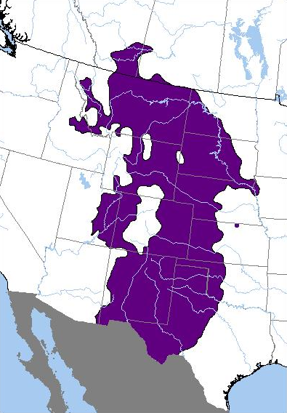
Prairie Rattlesnake
Characteristics: Prairie rattlesnakes are venomous pit vipers native to western North America. These snakes are usually lightly colored in hues of brown. Patches of dark brown are often distributed on the dorsal side. A color band may be seen at the back of the eye. The western rattlesnake group carries the distinctive triangle-shaped head and pit sensory organs on either side of the head.
Distribution: Prairie rattlesnakes are found over much of the Great Plains, the eastern foothills and some valleys of the Rocky Mountains, from southwestern Canada through the United States to northern Mexico. Prairie rattlesnakes seem to prefer dry areas with moderate vegetation coverage.
Habits and Lifestyle: They are typically active during the day in cooler weather and nocturnally during hot weather. Prairie rattlesnakes have poor eyesight and in order to find prey, they use their heat-sensitive pits or their forked tongue that picks up airborne scents. These snakes generally live alone but hibernate communally during cold winter months. They are not considered to be very aggressive but will defend themselves if threatened or injured. As with other rattlesnake species, Prairie rattlesnakes will rapidly vibrate their tails, which produces a unique rasping sound to warn intruders.
Diet and Nutrition: Prairie rattlesnakes are carnivores and prefer to prey on small mammals, such as ground squirrels, ground nesting birds, mice, rats, small rabbits, and prairie dogs. They will occasionally feed on amphibians and reptiles, and sometimes even other snakes.

Slide 39
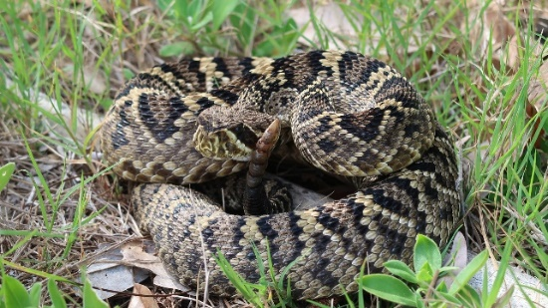
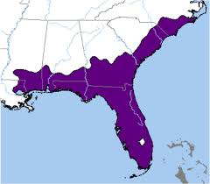
Eastern Diamondback Rattlesnake
Characteristics: The Eastern diamondback rattlesnake is a venomous pit viper native to the southeastern United States. It is the heaviest venomous snake in the Americas and the largest rattlesnake. These rattlesnakes have brownish, brownish-yellow, brownish-gray or olive ground color, overlaid with a series of 24-35 dark brown to black diamonds with slightly lighter centers. Each of these diamond-shaped blotches is outlined with a row of cream or yellowish scales.
Distribution: Eastern diamondback rattlesnakes are found in the southeastern United States from southeastern North Carolina, south along the coastal plain through peninsular Florida to the Florida Keys, and west along the Gulf Coast through southern Alabama and Mississippi to southeastern Louisiana. They inhabit upland dry pine forest, pine and palmetto flatwoods, sand hills and coastal maritime hammocks, longleaf pine/turkey oak habitats, grass-sedge marshes, and swamp forest, cypress swamps, mesic hammocks, sandy mixed woodlands, xeric hammocks, and salt marshes, as well as wet prairies during dry periods.
Habits and Lifestyle: Eastern diamondback rattlesnakes are solitary and frequently shelter by tunneling in gopher and tortoise burrows, emerging in the early morning or afternoon to bask. During cold winter months in some areas of their range, Eastern diamondbacks hibernate usually in mammal burrows, hollow logs, or among tree roots.
Diet and Nutrition: Eastern diamondback rattlesnakes are carnivores. They feed on small mammals, especially rabbits and rice rats, birds and large insects.

Slide 40
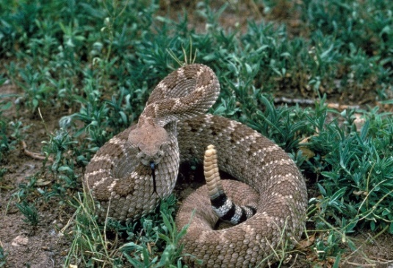
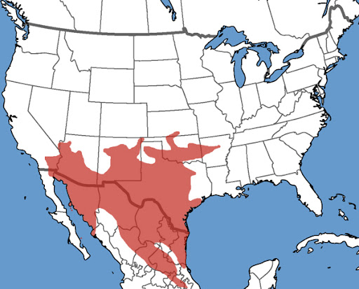
Western Diamondback Rattlesnake
Characteristics: The Western diamondback rattlesnake is a medium-sized venomous snake found in Northern America. The color pattern od these snakes generally consists of the dusty-looking gray-brown ground color, but it may also be pinkish-brown, brick red, yellowish, pinkish, or chalky white. This ground color is overlaid dorsally with a series of dorsal body blotches that are dark gray-brown to brown in color. Some of the first few blotches may be somewhat rectangular, but then become more hexagonal and eventually take on a distinctive diamond shape, hence the name "diamondback rattlesnake".
Distribution: Western diamondback rattlesnakes are found in the United States from central Arkansas to southeastern and Central California.
Habits and Lifestyle: Western diamondback rattlesnakes are generally solitary creatures. These snakes hunt mainly at night or in the early morning. In the winter, they hibernate in caves or burrows, sometimes with many other species of snakes. They are one of the more aggressive rattlesnake species in the US.
Diet and Nutrition: Western diamondback rattlesnakes are carnivores. They feed on small mammals such as chipmunks, prairie dogs, voles, woodrats, rabbits, ground squirrels and also birds, lizards, and even fish.

Slide 41
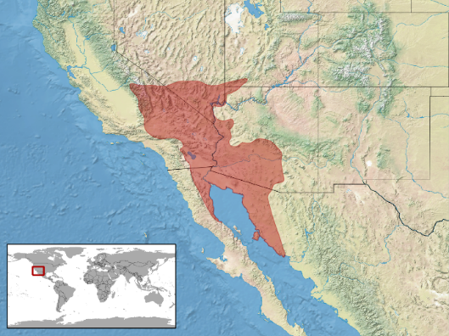
North American Sidewinder Rattlesnake
Characteristics: The color pattern of these snakes consists of a ground color that may be cream, buff, yellowish-brown, pink, or ash gray, overlaid with 28-47 dorsal blotches.
Distribution: Sidewinders are found in the southwestern United States and northwestern Mexico.
Habits and Lifestyle: They are nocturnal during hot months and become diurnal during the cooler months, which is roughly from November to March. In order to stay cool, sidewinders spend most of their time in rodent burrows, the rest time is spend lying coiled up partially buried in the sand waiting on prey. These snakes take their common name from an unusual form of locomotion. As their body progresses over loose sand, they form a letter J-shaped impression, with the tip of the hook pointing in the direction of travel. These snakes are generally lead a solitary life but may gather in groups during hibernation.
Diet and Nutrition: Sidewinders are carnivores. They feed on rodents such as mice and rats, but also lizards, snakes, and birds. Juveniles prefer to hunt lizards.

Slide 42
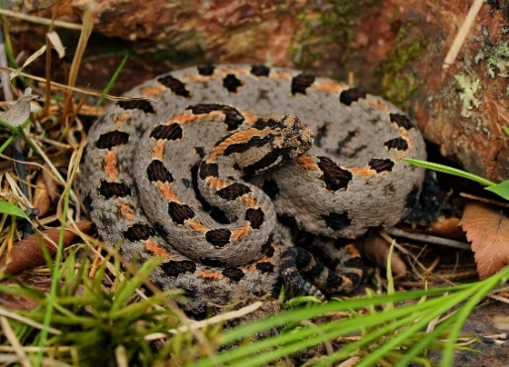
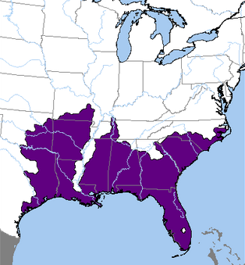
Pygmy Rattlesnake
Characteristics: The Pygmy rattlesnake is a small venomous snake native to the United States. The dorsal pattern of these snakes consists of a series of oval or subcircular spots with reasonably regular edges. The spots on the flanks are mostly round.
Distribution: Pygmy rattlesnakes are found in the Southeastern United States from southern and eastern North Carolina, south through peninsular Florida and west to East Texas and Oklahoma. These snakes tend to live in flatwoods, sand hills, mixed forests, and floodplains. They are also found near lakes and marshes.
Habits and Lifestyle: Pygmy rattlesnakes are generally solitary and interact with each other only during the mating season. They are diurnal and usually seen in the summer sunning themselves or crossing the road late in the day. Pygmy rattlesnakes do not dig their own burrows, but rather use those dug by small rodents or Gopher tortoises. These snakes hunt their prey by active pursuit, grabbing and flipping it around while simultaneously injecting venom to prevent injury by the victim. They also ambush lizards such as skinks by using their tails as lures.
Diet and Nutrition: Pygmy rattlesnakes are carnivores (insectivores). Their diet includes small mammals and birds, lizards, frogs and insects including giant desert centipedes. They also feed on other snakes.

Slide 43
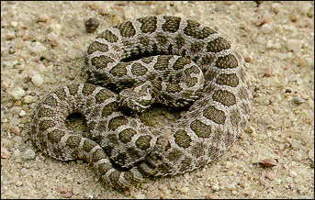
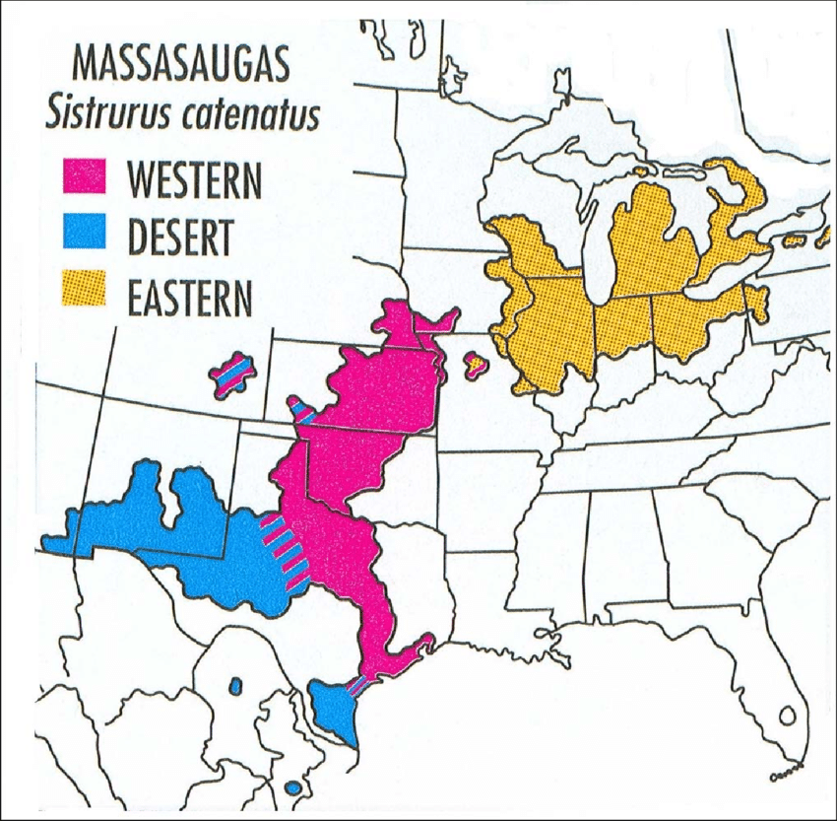
Massasauga Rattlesnake
Characteristics: Massasaugas are grey or tan in color with a row of large rounded brown/black blotches or spots down the center of the back and three smaller rows of alternating spots down each side.
Distribution: Massasaugas are found in North America from Ontario, Canada, and western New York southwest to southeastern Arizona in the United States. These rattlesnakes live in various habitats ranging from swamps, bogs, sedge meadows, wet prairies and marshes to grasslands and forests. In the western part of their range, Massasaugas can be found in rocky hillsides, wetlands, scrub plains, desert grassland, and dry prairie.
Habits and Lifestyle: Massasaugas are diurnal and lead a solitary life. During hot summer months, they are usually active early morning and late evening trying to avoid the heat of the day. Massasaugas stay active from April till late October and hibernate during winter in small abandoned burrows of other small animals. These rattlesnakes are very good swimmers and can even hunt their prey in the water. They detect prey with the sense of smell and with the help of heat-sensitive pits located on their faces. They can also feel vibrations and have good eyesight.
Diet and Nutrition: Massasaugas are carnivores; they feed on small vertebrates, including mammals, lizards, and other snakes, as well as invertebrates such as centipedes. Adults feed mainly on rodents, while juveniles usually prey on reptiles: more often lizards in western populations and snakes in eastern ones.

Slide 44
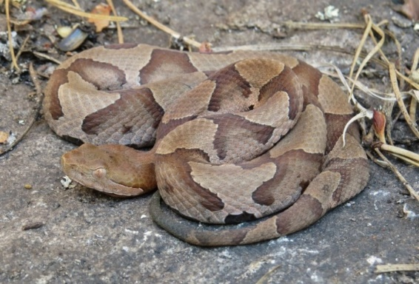
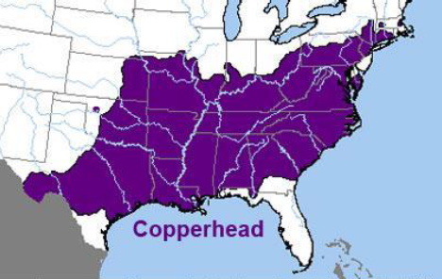
Copperhead Snake
Characteristics: The copperhead gets its name from the coppery-red color of the upper surface of the head. In eastern localities, the snake is marked with reddish-brown or chestnut hourglasses that cross the back.
Distribution: Over a large part of its range, the copperhead inhabits rocky, wooded areas. It also is found on the coastal plain and even in swampy areas in the South.
Habits and Lifestyle: Copperheads are highly terrestrial but may also climb trees to gorge on cicadas. These snakes are social and during the winter, they hibernate in dens or limestone crevices, often together with Timber rattlesnakes and Black rat snakes. They also can be found in groups near den sites, while basking in the sun, drinking, eating and during the breeding season. During hot summer months, Copperheads are active during the night but in the spring and fall, they become diurnal. Like all pit vipers, Copperheads are generally ambush predators; they take up a promising position and wait for suitable prey to arrive. When lying on dead leaves or red clay, they can be almost impossible to notice. They frequently stay still even when approached closely, and generally strike only if physical contact is made.
Diet and Nutrition: The Copperhead is a carnivorous species. Most of its diet consists of small rodents, such as mice and voles. It also hunts insects, frogs, lizards, salamanders, and other small creatures.

Slide 45
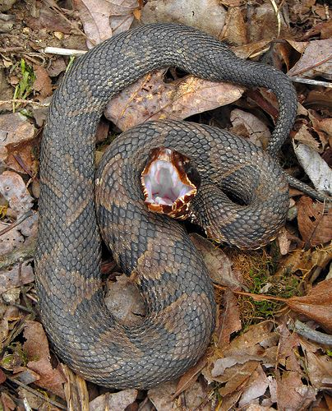
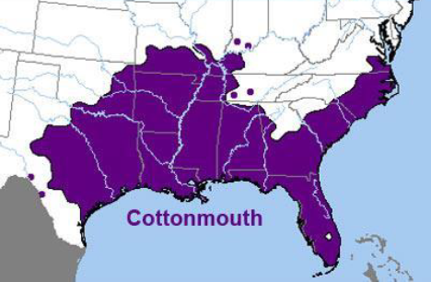
Cottonmouth Snake
Characteristics: Water moccasins are almost totally black, (with the exception of the head). The color pattern may consist of a brown, gray, tan, yellowish-olive, or blackish ground color, which is overlaid with a series of 10-17 dark brown to almost black crossbands.
Distribution: Water moccasins are found in the eastern US from southeast Virginia, south through the Florida peninsula and west to Arkansas, eastern and southern Oklahoma, and western and southern Georgia. Their range also includes the Ohio River Valley as far north as southern Indiana. These snakes are usually associated with bodies of water, such as creeks, streams, marshes, swamps, and the shores of ponds and lakes. They are also found in brackish-water habitats and are sometimes seen swimming in saltwater. Water moccasins are not limited to aquatic habitats.
Habits and Lifestyle: Water moccasins are solitary creatures. They may be active during the day and at night. However, on bright, sunny days, they are usually found coiled or stretched out somewhere in the shade. In the morning and on cool days, they can often be seen basking in the sunlight. They often emerge at sunset to warm themselves on the warm ground (i.e., sidewalks, roads) and then become very active throughout the night, when they are usually found swimming or crawling.
Diet and Nutrition: Water moccasins are carnivores and their diet includes mammals, birds, amphibians, fish, frogs, snakes, small turtles, and small alligators. On occasion, juveniles feed on invertebrates. These snakes are opportunistic feeders and sometimes eat carrion, making them one of the few snakes to do so.

Slide 46
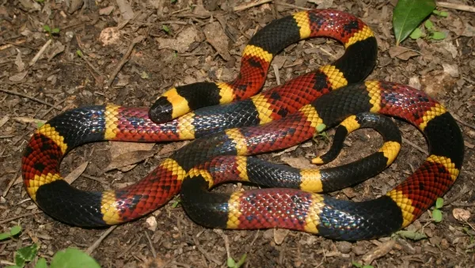
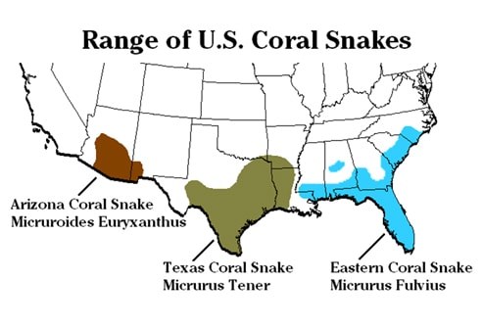
Coral Snake
Characteristics: Their color pattern consists of a series of rings that encircle their bodies: wide red and black rings separated by narrow yellow rings. The head of these snakes is black to just behind the eyes. The red rings are usually speckled with black.
Distribution: The range of Eastern coral snakes extends from southeastern North Carolina, south through South Carolina and Florida, and westward through southern Georgia, Alabama and Mississippi to southeastern Louisiana. They inhabit dry areas with open ground that are bushy but not heavily vegetated.
Habits and Lifestyle: Eastern coral snakes are very secretive and spend most of their time underground. They are most active in the spring and fall; during cold months these snakes hibernate in their burrows. These are solitary creatures that do their hunting by day. They move mainly on the ground and usually do not climb trees or shrubs. Eastern coral snakes are not aggressive and when they feel threatened will elevate and curl the tip of their tail and may release gas to frighten predators.
Diet and Nutrition: Eastern coral snakes are carnivores. They eat lizards, frogs, and smaller snakes, including other coral snakes.

Slide 47
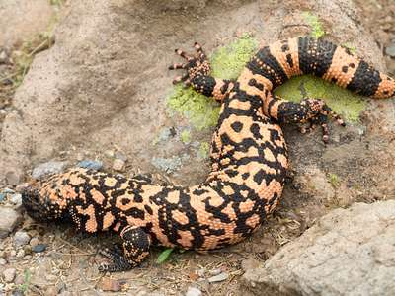
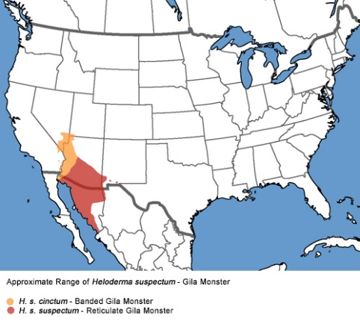
Gila Monster
Characteristics: The Gila monster is a heavy slow-moving venomous lizard. The body of these lizards is covered with bumpy looking scales. They are black and orange or pink in color and are actually small bones under the scales.
Distribution: Gila monsters are found in the Southwestern United States and Mexico. They inhabit scrubland, desert, and oak or pine-oak woodland, seeking shelter in burrows, thickets, and under rocks in locations with ready access to moisture.
Habits and Lifestyle: Gila monsters spend 90% of their time underground in burrows or rocky shelters. They are active in the morning during the dry season (spring and early summer); later in the summer, they may be active on warm nights or after a thunderstorm. These lizards are generally solitary creatures but may gather in communal areas and share shelters. Gila monsters have poor eyesight and when they hunt, they use their extremely acute sense of smell to locate prey, especially eggs. During cold winter months, these lizards hibernate in their burrows until spring.
Diet and Nutrition: Gila monsters are carnivores (scavengers). Their diet includes small birds, small mammals, frogs, smaller lizards, insects, bird and reptile eggs and carrion.

Slide 48
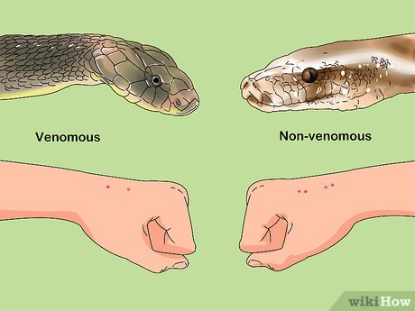
Venomous Snake Bites: Symptoms
Signs or symptoms of a snake bite may vary depending on the type of snake, but may include:
Puncture marks at the wound
Redness, swelling, bruising, bleeding, or blistering around the bite
Severe pain and tenderness at the site of the bite
Nausea, vomiting, or diarrhea
Labored breathing (in extreme cases, breathing may stop altogether)
Rapid heart rate, weak pulse, low blood pressure
Disturbed vision
Metallic, mint, or rubber taste in the mouth
Increased salivation and sweating
Numbness or tingling around face and/or limbs
Muscle twitching

Slide 49
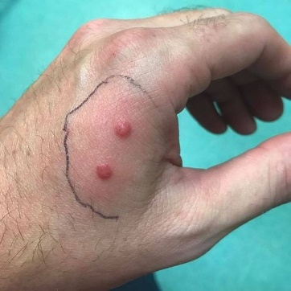
Venomous Snake Bites: First Aid
Victims should take these steps if a snake bites them:
Seek medical attention as soon as possible (dial 911).
Antivenin is the treatment for serious snake envenomation. The sooner antivenin can be started, the sooner irreversible damage from venom can be stopped.
Driving oneself to the hospital is not advised because people with snakebites can become dizzy or pass out.
Take a photograph of the snake from a safe distance if possible. Identifying the snake can help with treatment of the snakebite.
Keep calm.
Apply first aid while waiting for EMS staff to get you to the hospital.
Lay or sit down with the bite in a neutral position of comfort.
Remove rings and watches before swelling starts.
Wash the bite with soap and water.
Cover the bite with a clean, dry dressing.
Mark the leading edge of tenderness/swelling on the skin and write the time alongside it.

Slide 51
Requirement 8
Do ONE of the following:
Maintain one or more reptiles or amphibians for at least a month. Record food accepted, eating methods, changes in coloration, shedding of skins, and general habits; or keep the eggs of a reptile from the time of laying until hatching; or keep the eggs of an amphibian from the time of laying until their transformation into tadpoles (frogs) or larvae (salamanders). Whichever you chose, keep records of and report to your counselor how you cared for your animal/eggs/larvae to include lighting, habitat, temperature and humidity maintenance, and any veterinary care requirements.

Slide 52
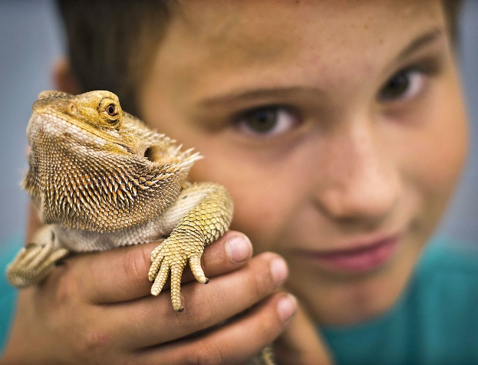
Keeping a Reptile or Amphibian as a Pet
Keeping a reptile or amphibian as a pet is usually easier than taking care of a mammal or bird—a dog or parrot, for example.
A snake or a frog needs feeding only once or twice a week and does not have to be taken for walks.
Certain rules and precautions must be followed to ensure the health and safety of both pet and owner.

Slide 53
Policy Statement on Keeping Caged Animals
Under prescribed conditions, the Boy Scouts of America approves the confinement of small animals in local or national camps or in special events or shows, as part of a learning experience (such as meeting merit badge requirements) in natural history and conservation.
In all cases where animals are kept in captivity, six requirements must be met and enforced:
Local, state, and federal laws are observed; necessary legal permits are obtained and made readily available.
A competent, qualified individual supervises the housing, feeding, and maintenance of the animals.
The animals are kept and properly cared for in adequate, sanitary cages as recommended by knowledgeable authorities.
Guidance on care and feeding has been obtained from an experienced and knowledgeable individual at a university, zoo, museum, nature center, or veterinary clinic, or from a local wildlife expert.
The animals involved are used to tell a nature/conservation story—for example, their habitat requirements, what they eat, their predators, and their place in nature.
All animals are returned to the wild at the location of original capture or to an appropriate facility after meeting merit badge requirements or the close of camp. However, check with your merit badge counselor for those instances where the return of these specimens would not be appropriate.

Slide 54
Keeping a Reptile or Amphibian as a Pet
A satisfactory container for most small reptiles and amphibians can be made from a 10- to 15-gallon aquarium.
The lid must be tight, otherwise your specimens will push it off and escape. To create your own lid, make a wooden frame just large enough to fit snugly around the aquarium’s outside upper edge and then tack wire or plastic screen onto this frame.
Flooring for some species should consist of small, carefully washed pebbles. Avoid sand and dirt. Both are messy and can work their way under reptile scales, inviting infections. For snakes and lizards, a flooring of neatly folded newspapers, six to eight sheets thick, can be used. Newspaper absorbs excess moisture and is easily replaced when soiled.
Shelter of some kind is an absolute necessity. Most reptiles and amphibians must have a place where they can hide and feel safe; otherwise they may prowl constantly, refuse all food, and soon die. A simple type of shelter is a piece of bark with the concave side down. Or, small flat stones can be piled up carefully to provide hiding places large enough for the specimen to coil or lie comfortably beneath them. Snakes and some lizards will use a shelter made from a small cardboard box or plastic container that has a hole large enough to enter with ease.

Slide 55
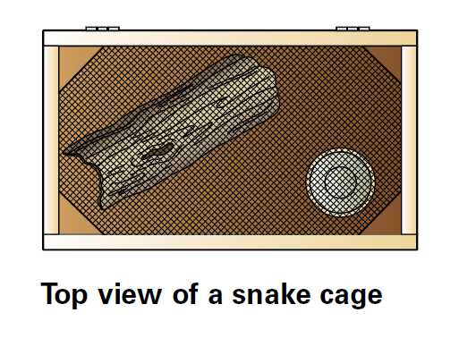
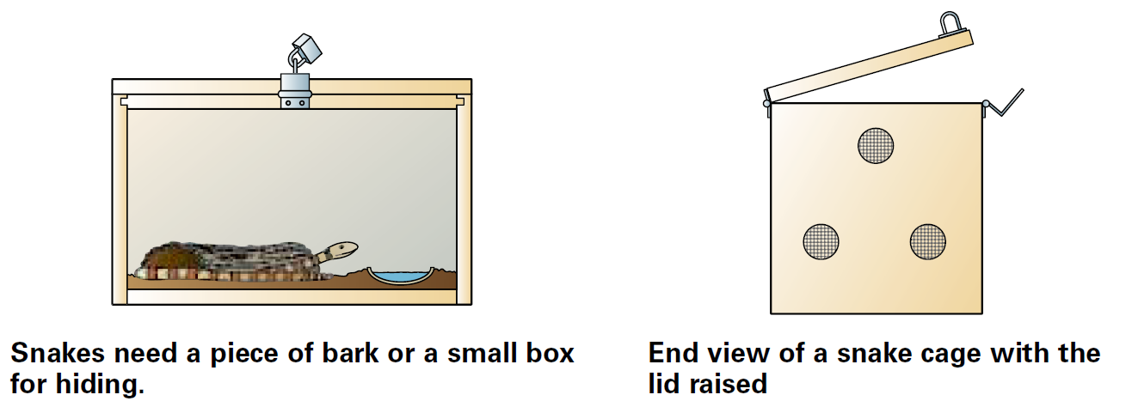
Keeping a Reptile or Amphibian as a Pet

Slide 56
Keeping a Reptile or Amphibian as a Pet
Be careful of using treated tap water in your aquarium—it may contain chlorine and other chemicals that can kill amphibians.
If this is your only option, let the tap water sit out for at least 24 hours to give the chlorine enough time to evaporate.
Other options are to use commercially bottled water or to use a dechlorination tablet sold for tropical fish aquariums.

Slide 57
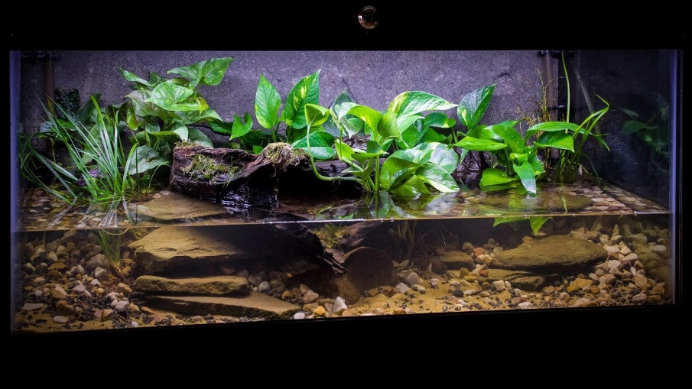
Keeping a Reptile or Amphibian as a Pet
In general, amphibians and aquatic turtles require moist conditions.
A good idea for amphibians is pour in enough water to make a small pool and place a bark or stone shelter at the waterline.
These animals need to dry off completely from time to time to avoid fungal infections.
Under such conditions the amphibian can be wet or dry as it chooses.

Slide 58
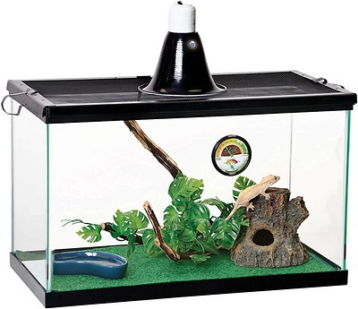
Keeping a Reptile or Amphibian as a Pet
Snakes and lizards need shallow water dishes for drinking and soaking.
Sometimes snakes soak too much and develop blisters on their bodies.
In such cases they should be given a water dish only for an hour or two each day.
Some small lizards will not drink water from a dish but will lap up drops of water.
Put a growing plant (in a flower pot) in the cage with them and sprinkle it gently every day, or spray a mist on the sides of the aquarium.

Slide 59
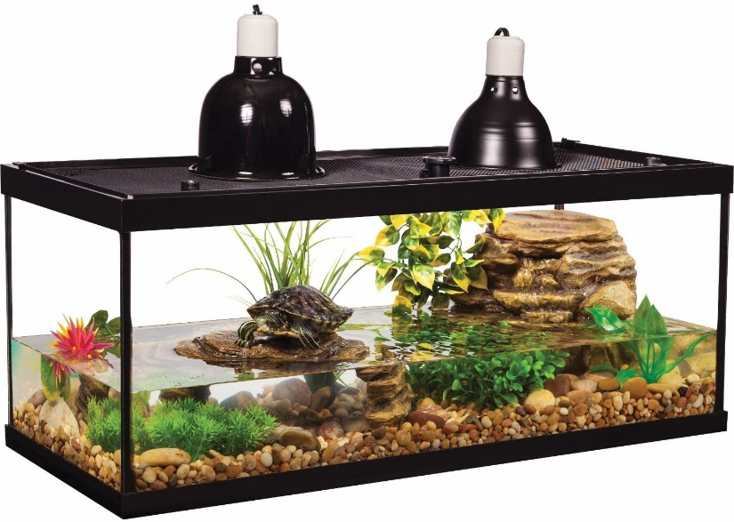
Keeping a Reptile or Amphibian as a Pet
Turtles can live in bare aquariums or plastic wading pools. For decorative purposes you can add clean pebbles at the bottom.
Most aquatic turtles should have a place above the water where they can crawl out and get completely dry when they want.
A piece of rough wood or large rock that projects above the water surface makes a good basking spot.
Box and wood turtles and the terrestrial tortoises need dry quarters, but shallow water dishes must be provided so that they can soak whenever they want.
Turtles kept indoors need occasional exposure to ultraviolet light. This can be accomplished by placing them in direct sunlight (sunlight that does not pass through a glass window) for a few hours each week, but be sure they do not get overheated. You also can use full-spectrum (with both UV-A and UV-B) ultraviolet bulbs in addition to a heat source.

Slide 60
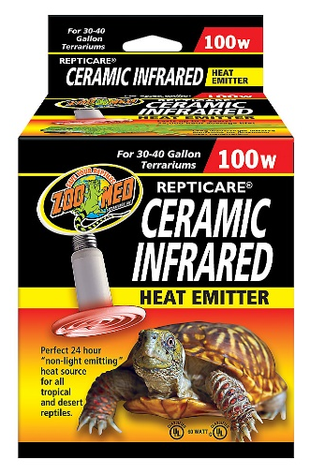
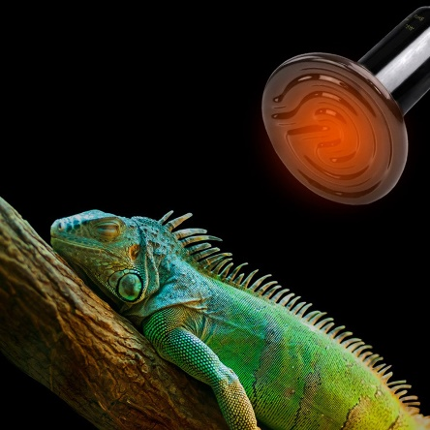
Keeping a Reptile or Amphibian as a Pet
Be careful not to keep your pets too hot or too cold.
The best temperature ranges are 60 to 70 degrees Fahrenheit for amphibians, 75 to 85 degrees for reptiles, and up to 90 degrees for some lizards and tortoises.
Experiment with an electric light for supplementary heat, but test it with a thermometer first so that you do not accidentally expose the animals to high temperatures that might be fatal.

Slide 61
Keeping a Reptile or Amphibian as a Pet
Feeding reptiles and amphibians is the most difficult part of keeping them as pets.
Avoid choosing an animal with specialized feeding habits like the rainbow snake, which eats eels, or the queen snake, which eats mainly soft-shelled crayfish.
You can keep garter and water snakes by feeding them minnows or small frogs and toads. Garter snakes often will eat earthworms also.
Many other snakes require mice, and you may be hard-pressed to obtain enough of these to keep your observations going.
Most snakes, however, can be trained to eat dead mice that were fresh-frozen and then thawed at room temperature.

Slide 62
Keeping a Reptile or Amphibian as a Pet
Frogs, salamanders, and lizards eat live insects, paying no attention to dead ones.
Crickets and grasshoppers can be captured on warm days to make good food for some species. Crickets also can be purchased at some bait stores.
If you live in a city and must depend on inanimate food, aquatic turtles are good choices for reptile pets. Most aquatic turtles live well on commercial turtle food pellets.
Most baby turtles will eat worms or insects, even dead ones. Do not give them any that have been killed by fly sprays or pesticides. You may poison the turtles if you do.

Slide 63
Keeping a Reptile or Amphibian as a Pet
An important part of keeping a reptile or amphibian for a pet is releasing it back into the wild when you no longer want to keep it.
If you have captured the animal yourself, you should return it to the spot where you caught it.
Do not release animals that appear sick, though, as a disease might be transmitted to individuals living in the natural population.
Also, you should never release a species into a habitat where it is not native.
Instead, consult with your merit badge counselor, a local zoo, or your state’s wildlife department about how to dispose of specimens that are inappropriate for release into the wild.
Invasive Python in Everglades

Slide 64
Requirement 8
Do ONE of the following:
Choose a reptile or amphibian that you can observe at a local zoo, aquarium, nature center, or other such exhibit (such as your classroom or school). Study the specimen weekly for a period of three months. At each visit, sketch the specimen in its captive habitat and note any changes in its coloration, shedding of skins, and general habits and behavior. Discuss with your counselor how the animal you observed was cared for to include its housing and habitat, how the lighting, temperature, and humidity were maintained, and any veterinary care requirements. Find out, either from information you locate on your own or by talking to the caretaker, what this species eats and what are its native habitat and home range, preferred climate, average life expectancy, and natural predators. Also identify any human caused threats to its population and any laws that protect the species and its habitat. After the observation period, share what you have learned with your counselor.

Slide 65
Toledo Zoo and Aquarium
2 Hippo Way, Toledo, OH 43609
Phone: (419) 385-4040
For your three-month study period, make sure you keep the same specimen under observation, and try to select an individual that can be expected to undergo some kind of change—for example, an immature amphibian approaching metamorphosis, a snake preparing to shed its skin, or a female preparing to give birth. A keeper or curator can help you choose an appropriate subject for the study.

Slide 66
Requirement 9
Do TWO of the following:
Identify at night three kinds of toads or frogs by their voices. Imitate the song of each for your counselor. Stalk each with a flashlight and discover how each sings and from where.
Identify by sight eight species of reptiles or amphibians.
Using visual aids, give a brief talk to a small group on three different reptiles and amphibians.

Slide 67
Calls of Frogs and Toads
Turn on computer speakers and click on the link Calls of Frogs and Toads of the Northeast to learn how to identify frogs and toads by their sounds.

Slide 68
Identifying Reptiles and Amphibians by Sight
Go to your local library for a field guide to reptiles and amphibians or download the following Field Guides:
Amphibians of Ohio Field Guide
Reptiles of Ohio Field Guide

Slide 69
Giving a Talk on Reptiles and Amphibians
The secret of success is to prepare your talk in advance.
Make an outline of what you want to say.
Remember that the people in your audience probably will know little about these animals.
Below are examples of what you might talk about and you should select topics and facts that you feel comfortable with and that are compatible with your live specimens.
Explain the differences between a reptile and an amphibian and use live specimens or pictures to illustrate important points.
You will need to spend some time studying books on reptiles and amphibians so that you know more about the subject than your audience does.
The resources section in the back of the merit badge pamphlet lists a great variety of resources.
Learn the answers to such questions as how a snake crawls, why it sticks out its tongue while you hold it, and why it has no eyelids.
Explain the difference between a land or box turtle and the aquatic kinds, pointing out the webbed feet of the latter.
Tell your audience why many kinds of lizards have tails that break off readily, or why turtle shells of different species vary in shape and color.
Explain the development of frogs and toads from egg to tadpole to adult.
Tell them what you find most exciting about reptiles and amphibians or about your observations of species in captivity or in the wild.
Be prepared to answer questions after you have finished.

Slide 70
Requirement 10
Tell five superstitions or false beliefs about reptiles and amphibians and give a correct explanation for each. Give seven examples of unusual behavior or other true facts about reptiles and amphibians.

Slide 71
Snake Myths
Snakes that live around barns milk cows.
Milk snakes eat many rats and mice, and barns and other farm buildings often are excellent places to find food.
So finding snakes around dairy farms is to be expected.
But the milk snake’s mouth is full of needle-sharp teeth for holding small animals and is not equipped for sucking milk from a cow.
Milk Snake

Slide 72
Snake Myths
Snakes swallow their young to protect them.
Many serpents, such as king snakes and racers, eat other snakes—sometimes even their own kind.
So if a person happened to come along at the right moment, it would be easy to jump to the conclusion that a mother snake was trying to protect her offspring.
The illusion would be strengthened if the larger snake was disturbed and disgorged the smaller one, enabling it to escape.
Indigo Snake Eats Rat Snake

Slide 73
Snake Myths
The whip snake will chase a person down, wrap around him, and thrash him to death.
The eastern coachwhip is one of the longest snakes in North America, reaching lengths of more than 7 feet.
The tail somewhat resembles a braided bullwhip.
This may be the source of the story about a snake that whips people.
Eastern Coachwhip Snake

Slide 74
Snake Myths
Snakes chase people.
No snakes in North America are habitually aggressive toward human beings and none is known to chase people.
A few, like the big diamondback rattlers and the cottonmouth, will sometimes stand their ground, and occasionally a snake will strike out if harassed.
But the average snake, given a fair chance to escape, will speedily get out of a person’s way.
Sometimes during the mating season racers and other snakes may feign an attack.
In order to reach their shelters, snakes may crawl directly towards a person who happens to be in the way.
Aggressive Snake Defending Itself

Slide 75
Snake Myths
A hoop snake rolls down hills with its tail in its mouth and has a venomous stinger in its tail.
One likely origin to the hoop snake myth is the mud snake found throughout the coastal plain.
The mud snake is very docile and refuses to bite, but its habit of pressing the spine-like tip of its tail against a captor's skin gives rise to the misconception that it can sting.
It's, therefore, given the nickname "stinging snake."
Southern folklore also holds that the mud snake can take its tail in its mouth and roll like a wheel, giving rise to the common name "hoop snake.“
The snake is not capable of moving in this manner, however.
Snakes do occasionally swallow their own tail mistaking it for prey, who knows, maybe this started the hoop snake myth.
Eastern Mud Snake
“Hoop Snake”
Snake Swallowing It’s Tail

Slide 76
Snake Myths
Snakes are cold and slimy
In fact, snake skin is dry and, depending on the surrounding temperature, can be quite warm and soft.

Slide 77
Snake Myths
Snakes Go Blind During the Heat of Summer
Snakes do not simply go blind based on temperature or time of year.
However, snakes close to shedding their skins do experience a temporary loss or inhibition of vision as their old ocular scales, protective scales covering the eyes, begin to separate from new ones developing underneath.
During this time, the eyes appear a milky gray-blue, and the snake’s ability to see is minimal.
A great many snakes slip into a shed cycle in late summer, so perhaps the myth that all snakes “go blind” was born during this time of year.
Molting Snakes

Slide 78
Snake Myths
When a snake is killed, its tail wriggles until sundown.
When a snake has met a violent death, reflex action often lasts quite a while afterward, and the tail can wriggle for some time, but sundown plays no part in it.
Eastern Hognose Snake Playing Dead

Slide 79
Snake Myths
Snakes are deaf
Although they lack eardrums, snakes possess inner ears which are able to pick up not only ground-borne vibrations but low frequency airborne sounds.
They do have difficulty with sounds at a higher pitch.
Vibrations received by the jaw stimulates the cochlea. From the cochlea, auditory signals travel to the brain.

Slide 80
Snake Myths
Snakes are charmed by music.
Snakes will often replicate the movement of their prey or whatever is threatening them to be in the attacking range.
Snake charmers play a long instrument that intimidates snakes.
Snakes lack true ears and cannot hear high frequency sounds.
However they can sense vibrations pretty well and this is exactly what the snake charmers use to attract the snake’s attention towards them.
They create vibrations by rapidly tapping their feet on the ground.
Snake Charmer

Slide 81
Snake Myths
Snakes travel in pairs, the survivor seeking revenge if one is killed.
One possible explanation could be related to typical reproductive behavior.
During the mating season a male snake will trail a female snake much as a buck deer trails a doe during the rut.
One may make the incorrect assumption that the second snake seen was out for revenge.
Mating Snakes

Slide 82
Snake Myths
A snake can hypnotize or "charm" its prey so that the animal is unable to escape from the snake.
There is no scientific evidence that snakes are able to do this.
A possible explanation for this false story is that a small animal may become frozen with fear at the approach of a snake.
Kaa Hypnotizing Mowgli (Jungle Book)

Slide 83
Snake Myths
A rattlesnake’s age can be determined by counting the number of rattles on its tail.
That assumes that a rattlesnake gains one rattle each year and that it never loses a rattle.
Neither assumption is accurate because a rattlesnake gains a new rattle each time it sheds its skin.
Young rattlesnakes will shed every few weeks, acquiring another tail bulb each time.
Old rattlesnakes may shed twice each year.
In addition, a rattlesnake does not hold onto all its rattles throughout its life.
Over time, some of the rattles break off and are lost.
Rattlesnake Tail

Slide 84
Amphibian Myths
Toads give people warts.
This is an old wives' tail that carries no truth.
Warts are caused by a human virus, rather than contact with amphibians.
Most amphibians, however, have moist and delicate skin, and many can secrete potentially toxic or irritating substances if ingested or threatened.
Warts on a Toad

Slide 85
Amphibian Myths
Licking a toad will cause you to hallucinate
This myth actually has a somewhat factual basis.
Both frogs and toads can secrete a substance called bufotoxin through glands behind their eyes when they are stressed or threatened.
This toxin is deadly when “raw” and many family pets are actually killed each year from accidentally ingesting bufotoxins from Cane toads.
You can lick a toad or frog in an attempt to get high and hallucinate, but more than likely you’ll just end up in the hospital.
Dog Ingested Cane Toad

Slide 86
Amphibian Myths
Frogs and toads rain down from the sky.
There have been reports of raining frogs and fish dating back to ancient civilization.
Of course, it doesn’t “rain” frogs or fish in the sense that it rains water.
Strong winds, such as those in a tornado or water spout are powerful enough to suck up a school of fish or frogs and “rain” them elsewhere.

Slide 87
Amphibian Myths
Salamanders like fires.
People believed that salamanders in general had the ability to withstand fire as they were often seen crawling out of logs that were put onto fires.
Fire Salamander

Slide 88
Amazing Reptile/Amphibian Facts
Gecko’s can detach their tail
Under times of extreme stress, a gecko can detach its tail. It’ll do this to confuse and escape from predators.
Known as autotomy, the gecko isn’t hurt in the process.
Cleverly the tail is designed to have a point of detachment surrounded with connective tissue; there’s also very little blood loss.
Gecko’s can grow their tail back!

Slide 89
Amazing Reptile/Amphibian Facts
Most people think that chameleons change color to hide themselves more easily.
In fact, Chameleons change color to communicate their mood. If they’re feeling calm, they‘ll be a pale color, if they’re feeling defensive they’ll be a darker color, and bright colors can be used to attract mates!
Color changes are also associated with temperature and light.
They’ll change to a darker color to retain heat and warmth, and to a lighter color to repel heat, and stay cool.

Slide 90
Amazing Reptile/Amphibian Facts
Snakes and lizards use their tongues to smell
They whip out their tongue and pick up scent particles in the atmosphere which are then transferred to the Jacobson organ in the reptile’s mouth.
This patch of sensory cells transfers the information to the brain, which is then interpreted. The reptile will then know more about the item and how to react.
The process can also be used to pick up pheromones from the opposite sex, and is essential for reptiles looking for a mate.

Slide 91
Amazing Reptile/Amphibian Facts
The sex of a turtle is determined by the temperature at which the egg is incubated, with warmer temperatures producing females, cooler temperatures producing males and temperatures in the middle resulting in a mixed clutch.
The situation is reversed for crocodiles, with males predominating at higher temperatures.
The gender of a snake is determined by chromosomes, as it is in the case of mammals and birds.

Slide 92
Amazing Reptile/Amphibian Facts
Leatherback sea turtles have existed in their current form since the age of the dinosaurs!
Leatherbacks are highly migratory, some swimming more than 10,000 miles a year between nesting and foraging grounds.
They are also accomplished divers with the deepest recorded dive reaching nearly 4,000 feet—deeper than most marine mammals.
They have spiny “papillae” lining their mouth and esophagus—these spines help them trap and consume their main prey species, jellyfish.

Slide 93
Amazing Reptile/Amphibian Facts
A small cave salamander, the olm also known as “the human fish,” has broken the world’s record for longest-lived amphibian – the salamander has the lifespan of over 100 years.
This creature has far longer lifespan than any other amphibian and scientists have no idea why.

Slide 94
Amazing Reptile/Amphibian Facts
The largest living amphibian is the 1.8 m (5 ft. 11 in.) Chinese giant salamander (Andrias davidianus)
This is dwarfed by the extinct 9 m (30 ft) Prionosuchus that lived about 270 million years ago.

